Slide 1
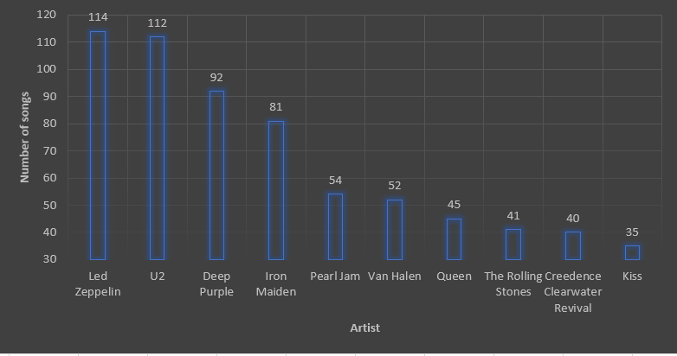
Top 10 Rock Songwriters
<visualization>
The bar graph explains the number of Rock songs for each songwriter. From the chart, we can see that led Zeppelin wrote 114 songs which make him at the top comparing to other songwriters. Then, comes U2 who wrote 112 songs. In the Third and Fourth place, 92 and 81 songs were written by Deep Purple and Iron Maiden. While the last six songwriters wrote between 54 and 35 songs.

Slide 2
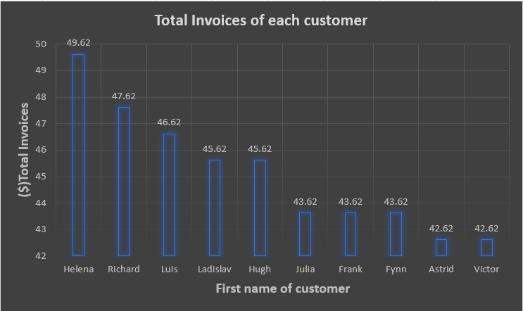
Top 10 Customers
As showing, this bar chart represents the total invoices by the first name of each customer. All the invoices are in the range of forty. Helena occupies the maximum rate by 49.62 while Richard is the closest customer to Helena by 47.62. The amout of total invoice slightly goes down by 1 for Luis compared to Richard. Ladislav and Hugh are in the same range which is 45.62. The following three customers Julia, Frank and Fynn take 43.62 in total. Both Asrid and Victor get the exact total invoice 42.62.
<visualization>

Slide 3
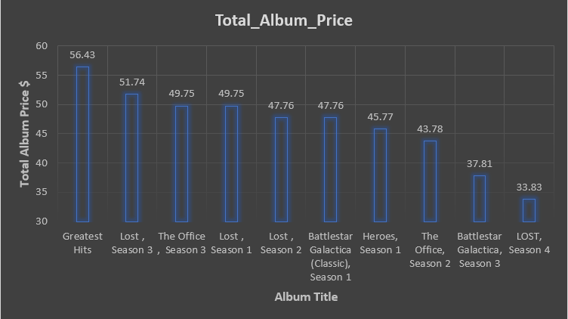
Album prices
This bar charts reveals the total album prices by considering the album title as mentioned in the X-axis. The Greatest hits is in the highest level among them by 56.43$. Then, comes Lost Season3 which cost 51.74$.The office season 3 and Lost season 1 are equally by 49.75$. Lost season 4 is the cheapest compered to others. The price 47.76$ goes to Lost season 2 and Battlestar Galactica season 1. The second lowest price is 37.81 for Battlestar Galactica season 3.
<visualization>

Slide 4
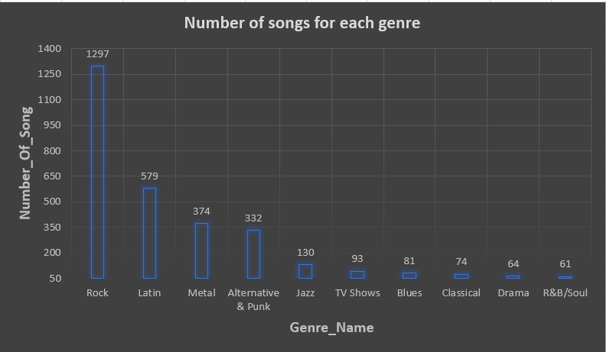
Songs Number for Each Music Genre
This Bar Graph shows the total number of songs for ten genres of Music. The x-axis indicates the Genre Name while the y-axis indicates the number of songs.
The highest number of songs goes to Rock music by 1297 songs. Whereas, the lowest figure is for R&B/Soul Music by 61 songs. Comparing to Rock Music, we noticed a diminishing which is about 700 songs, and this makes the Latin Music in the second place by 579 songs. The remaining music genres have between 374 and 64 based on each music genre as showing in the bar graph.
<visualization>

